Slide 1


<General_Assembly> <EDA_project>
`2021 Kaggle Survey Analysis`
`Done by` : Zainab Alhashemi, Ali Raza, Ali Kashkool
Here your text

Slide 2

<General_Assembly> <EDA_project>
Table Of `Contents`
01
}
}
Dataset Overview
}
02
}
Analysis & Insights
}
03
}
{Recommendation}

Slide 3

<General_Assembly> <EDA_project>
{01}
Dataset Overview`
A 2021 Kaggle survey conducted yearly to get a full picture of the data science and machine learning field.
The survey was open from Sep 1 to Oct 4, 2021 with over 25,000 responses.
Dataset includes information on who is working with data, how machine learning is being used in different industries, and how beginners can start a career in data science.
}
}

Slide 4

<General_Assembly> <EDA_project>
02
Analysis`/ Insights
}
}
Who is working with data?
Exploring age groups, educational backgrounds, location, job titles, & salary ranges.
How is it used in different industries?
Exploring salary ranges by job titles, analyzing employment industries.
What is the most loved programming language?

Slide 5
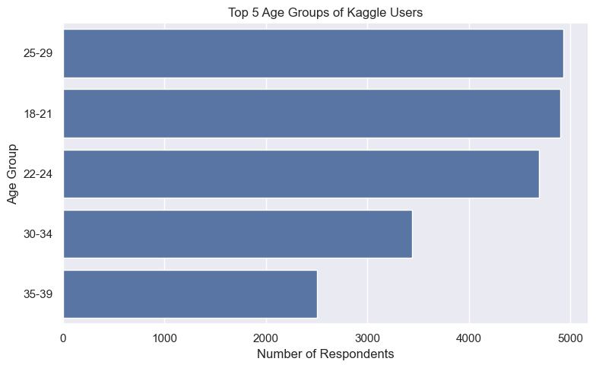
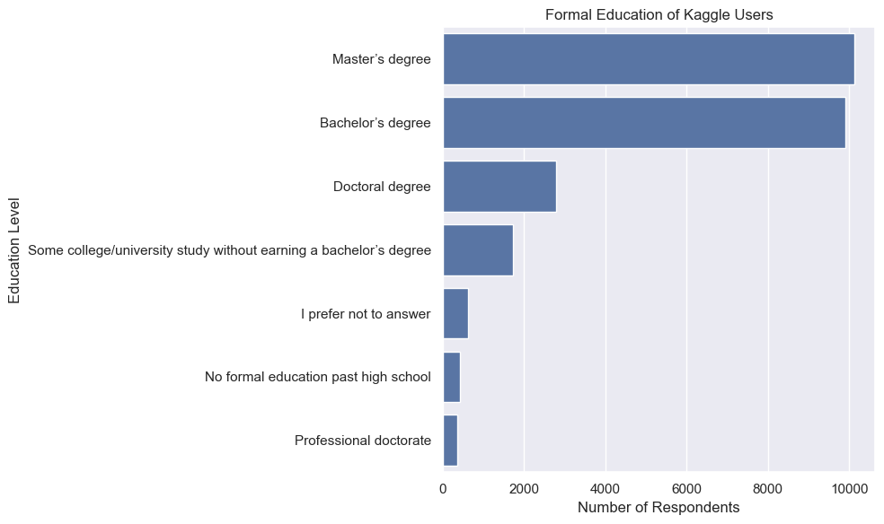

<General_Assembly> <EDA_project>
Age Distribution & Educational level
Most Kaggle users in 2021 are between the ages of 18 to 29
With Masters or Bachelor Degrees

Slide 6
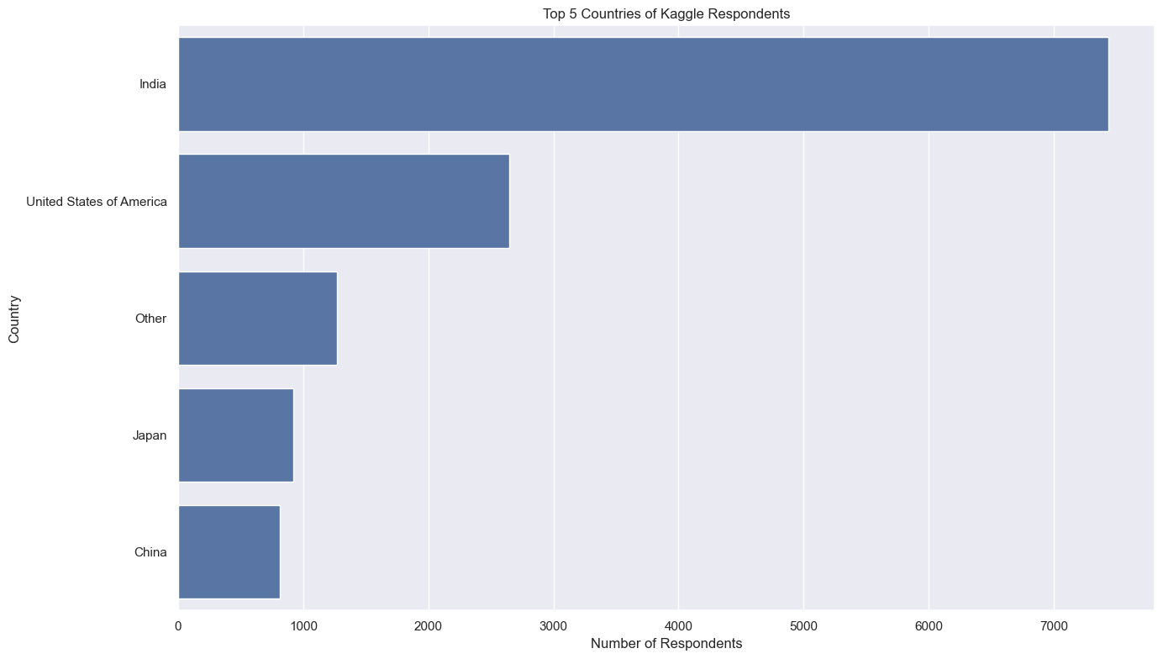
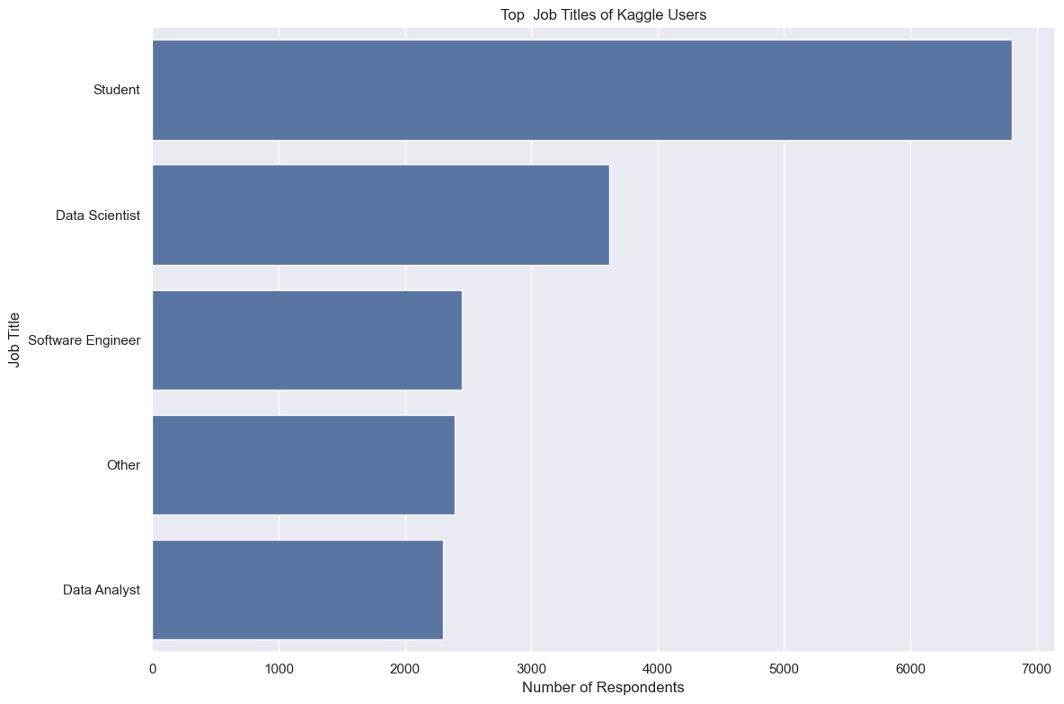
<General_Assembly> <EDA_project>
Location & Job Title
Most Kaggle users in 2021 are located in India, USA, Japan & China
Most are either students, data scientists, software engineers, or data analysts
Suggesting that they are either studying their Masters or Bachelors
Notes:
Most are students suggesting that they are studying either their Masters or Bachelors

Slide 7
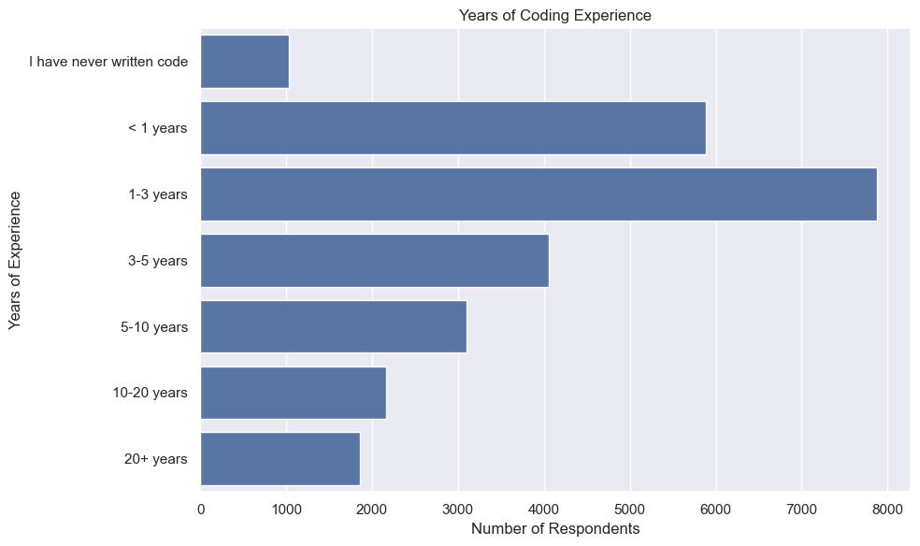
<General_Assembly> <EDA_project>
Years of Experience in coding`
Majority of users have between less than a year or 3 years of experience

Slide 8
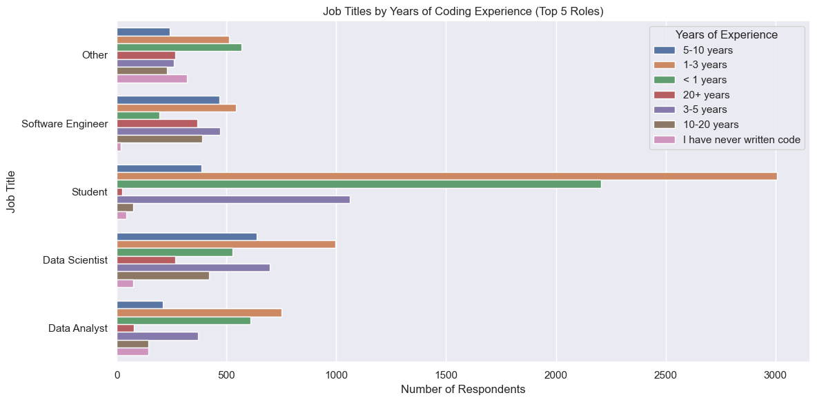

<General_Assembly> <EDA_project>
Job titles by Years of Experience
Shows that success in data work doesn’t require 10+ years of experience

Slide 9
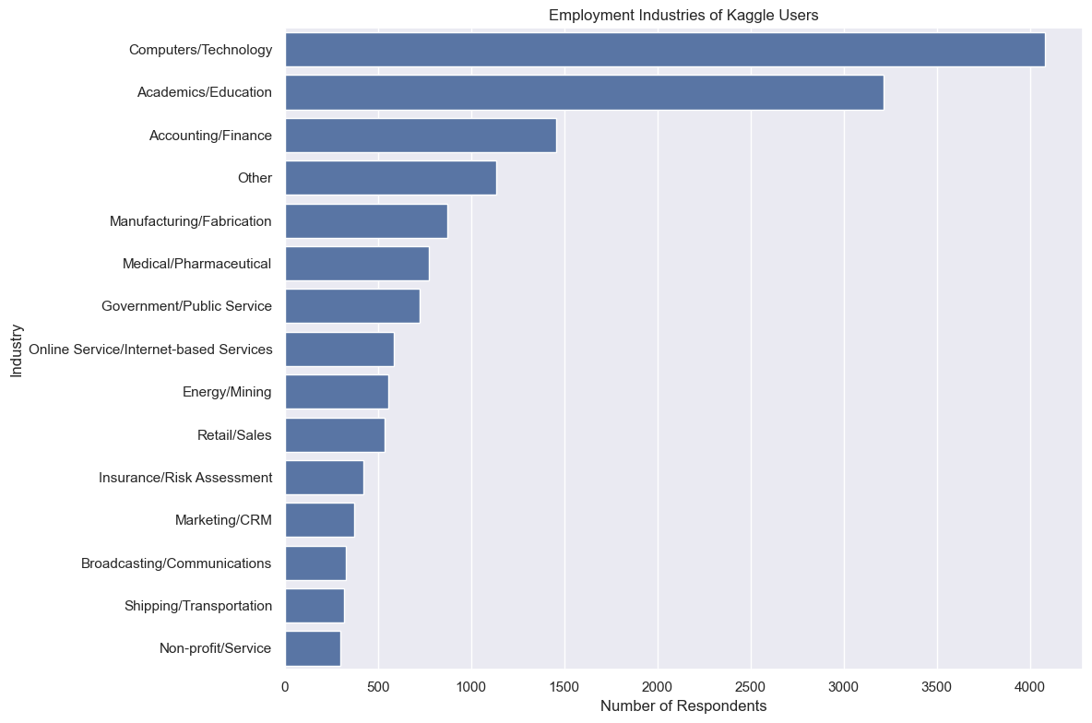
<General_Assembly> <EDA_project>
Employment Industries
Top 3 industries include: Computer/Technology, Academics/Education, Accounting/Finance

Slide 10
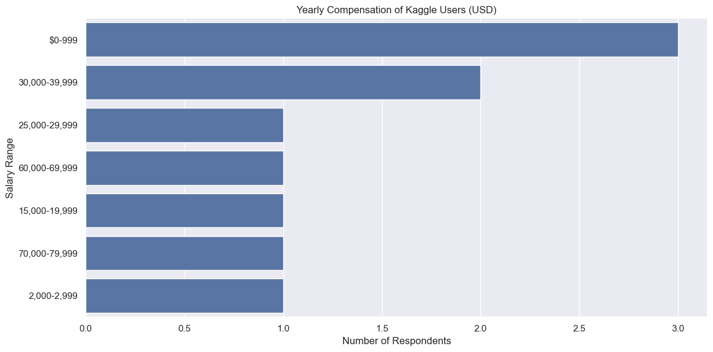
<General_Assembly> <EDA_project>
`Top 5 Salary Ranges
Since most users are students their yearly income is from $0-999
Second highest income of users is $30,000-$39,000 per year (2.5-3.25K per month)

Slide 11
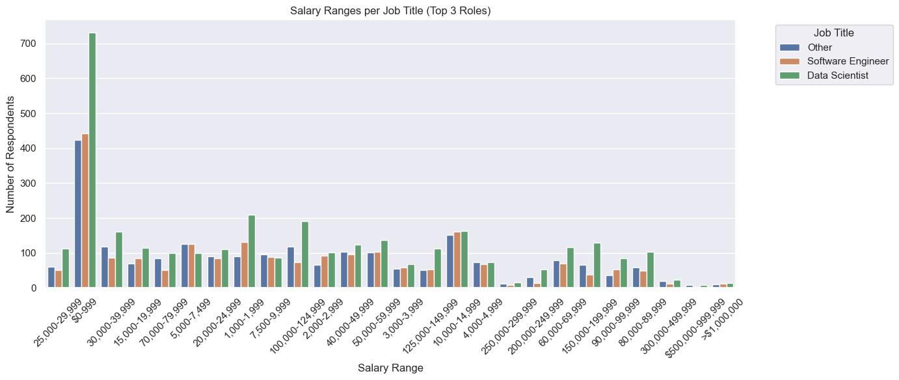
<General_Assembly> <EDA_project>
Salary Ranges & Job Titles
This chart demonstrates that in all salary ranges, data scientists are more than software engineers suggesting that data science is more demanding.

Slide 12

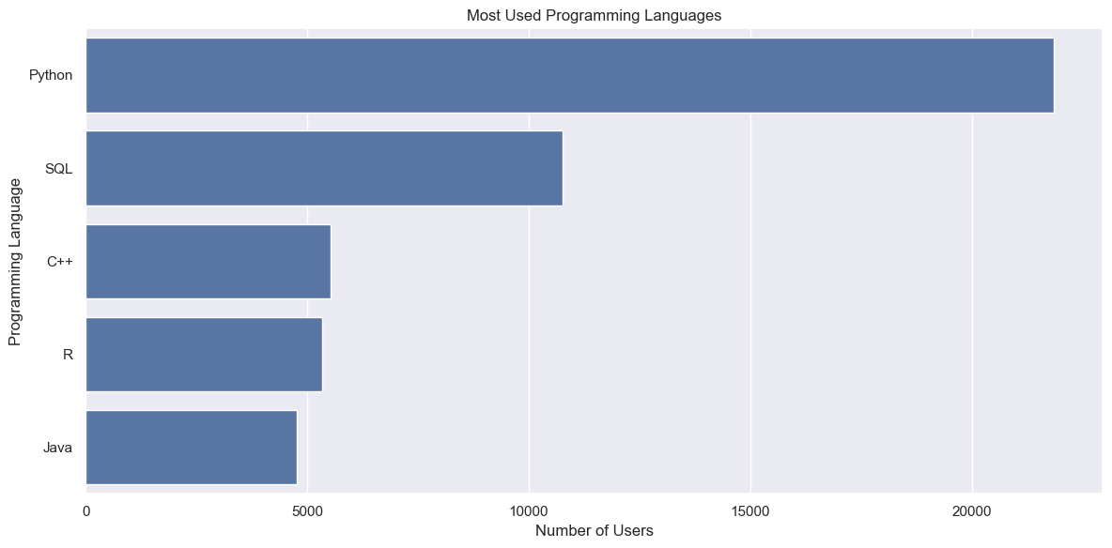
<General_Assembly> <EDA_project>
Most <3 programming Languages
Python
SQL
C++
R
Java

Slide 13

<General_Assembly> <EDA_project>
}
03
}
‘Recommendation
Take your Masters Degree
Invest in Data science or software engineering
Working with data is not limited to one sector/industry
You can start with Python!

Slide 14

<Company> <Lesson>
Thank You!}`

